Slide 1
STUDENT PORFOLIO WEB APPLICATION
VISHNU SELVAN 7376232AG152 AGRICULTURE ENGINEERING

Slide 2
INTRODUCTION:
The Student Portfolio Builder is a website that helps students create their own professional portfolio easily.
In today’s world, having an online portfolio is important to show skills, projects, and achievements.
This project gives students a simple and easy platform where they can enter their details and quickly create a clean and structured portfolio using modern web technologies.

Slide 3
LITERATURE SURVEY:
1) The Use of Students’ Portfolio within the Assessment Process at University Level during the Covid-19 Pandemic – Maria Carmen Țiru
This study examines the role of student portfolios in university assessment during the COVID-19 pandemic. It concludes that e-portfolios are effective formative assessment tools that help students demonstrate knowledge, subject-specific skills, and professional competencies while improving teaching and learning outcomes.
LINK: CEEOL - Article Detail
2) e-Portfolio: A Tool to Assess University Students' Skills – Silvia Rodriguez-Donaire, Beatriz Amante García, and Sonia Oliver del Olmo (IEEE)
This study investigates the implementation of e-portfolios in engineering education at the Polytechnic University of Catalonia. The results show that e-portfolios act as an effective complementary assessment tool and help in continuously monitoring students’ competency development throughout their academic programs.
Link: e-Portfolio: A tool to assess university students' skills | IEEE Conference Publication | IEEE Xplore
From the reviewed studies, it is evident that e-portfolio systems enhance assessment processes, improve skill tracking, and support competency-based education. However, most existing implementations focus mainly on evaluation within academic institutions. This creates an opportunity to design a student-centered portfolio builder that not only supports assessment but also enables students to showcase their skills professionally for career opportunities..

Slide 4
PROBLEM STATEMENT:
In today’s competitive academic and professional environment, students are expected to present their skills and achievements in a structured and professional manner
Existing solutions often require paid subscriptions, advanced customization skills, or offer limited flexibility. As a result, students struggle to build personalized portfolios that effectively represent their abilities.
Therefore, there is a need for a user-friendly, efficient, and accessible web-based system that enables students to create and manage professional portfolio websites easily, without requiring extensive technical knowledge.
The proposed Student Portfolio Builder addresses this need by providing a streamlined interface, real-time preview functionality, and structured data management to help students showcase their profiles effectively.

Slide 5
Tech Stack - The Student Portfolio Builder is developed using the following technologies:
Frontend
HTML – Used to create the structure of the website
CSS – Used for styling and responsive design
JavaScript – Used for dynamic content and live updates
Backend
Python – Used for server-side logic
Flask / Django – Web framework for handling requests and APIs
Database
MySQL – Used to store user portfolio data
Version Control
Git & GitHub – Used for code management and collaboration

Slide 6
SYSTEM ARCHITECTURE:
User (Browser)
↓
Frontend (HTML, CSS, JS)
↓
Firebase Authentication (Google Auth)
↓
Backend Server (Python - Flask/Django)
↓
Database
(Firebase / SQL)

Slide 7
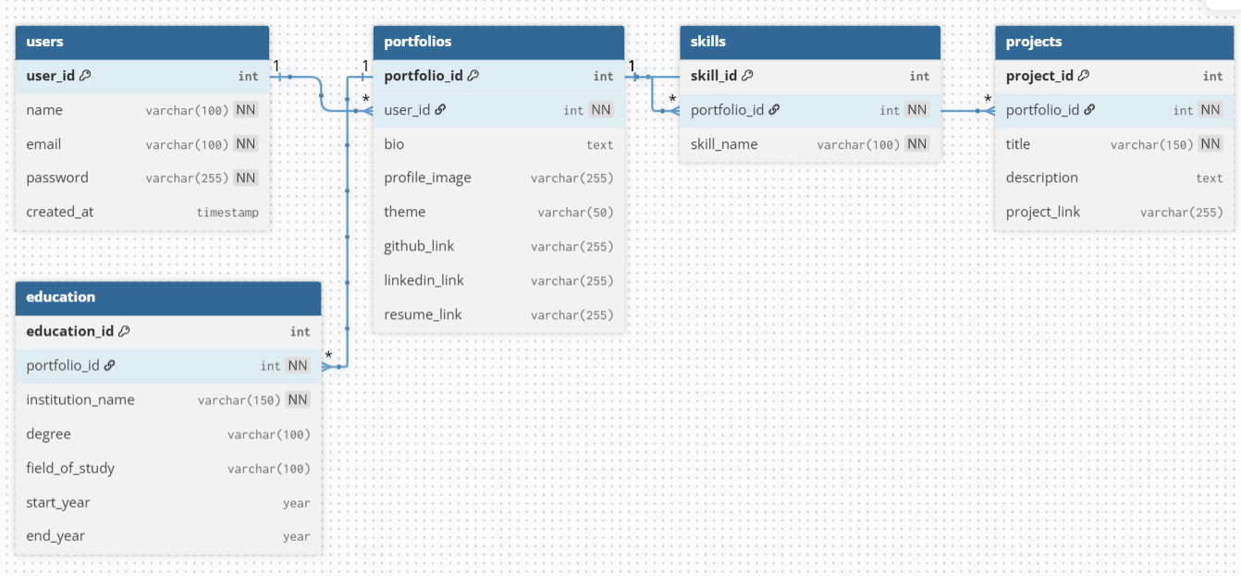
ER DIAGRAM:

Slide 8
WORK FLOW:
Start
↓
User Visits Website
↓
Login / Sign Up
↓
Authentication (Firebase / Backend)
↓
Fill Portfolio Details
↓
Submit Data
↓
Backend API Processing
↓
Store in MySQL Database
↓
Generate Portfolio View
↓
Display to User
↓
End

Slide 9
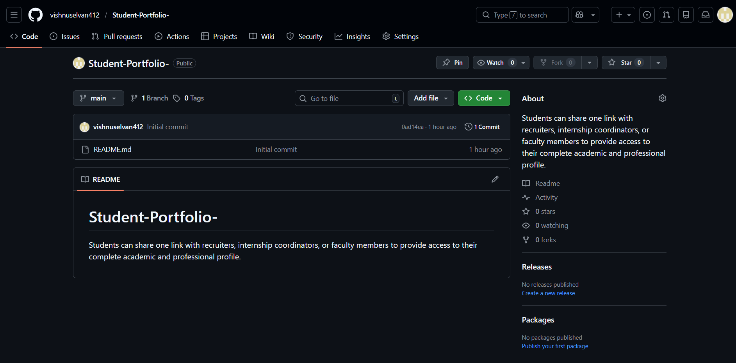
GITHUB:

Slide 10
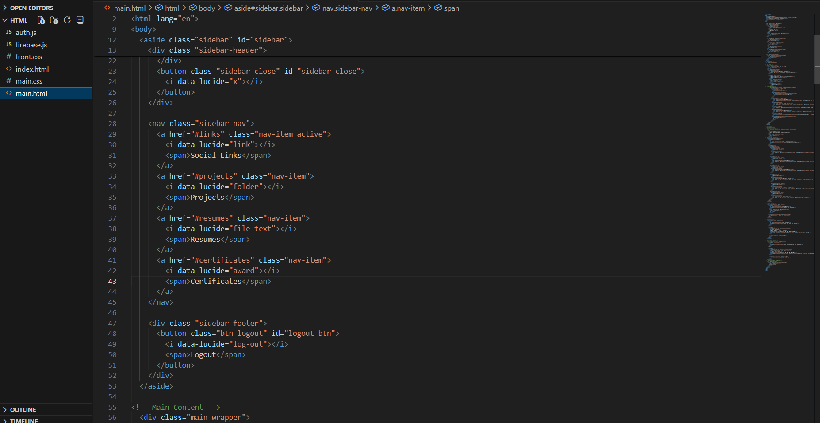
FRONT END:

Slide 11
THANK YOU

